Slide 1

Concepts in AI security & Adversarial Examples
From the Perspective of Adversarial Games
Derui (Derek) Wang
23 July 2021

Slide 2

Who is the Speaker

Slide 3
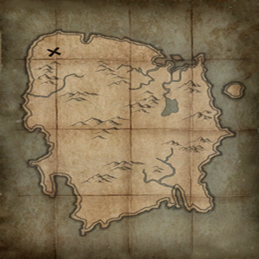




Mini Map for the Short (Yet Challenging!) Journey
Island of Adversarial Machine Learning
Start the game of AML
Game Theory Desert
Lurking in the dark
Den of AE
Search for them!
Vanguard of AE
You shall never pass !
Fort of Light
Farewell
Travel Point
Abbreviations:
AE: Adversarial Examples
AML: Adversarial Machine Learning
Sea of Machine Learning

Slide 4
Island of Adversarial Machine Learning
Start the game of AML
Game Theory Desert
Lurking in the dark
Den of AE
Search for them!
Vanguard of AE
You shall never pass !
Fort of Light
Farewell
Travel Point
Abbreviations:
AE: Adversarial Examples
AML: Adversarial Machine Learning
Sea of Machine Learning

Slide 5
Machine Learning and Deep Learning
A Recall of Classic Machine Learning Problems
Regression
Classification (Pattern recognition)
Density estimation
Popular Models in Machine Learning (Supervised/Unsupervised/Semi-supervised)
Linear, logistic, SVM, neural networks, …
Autoencoder, PCA, clustering, …
Deep Learning?
Deep neural networks → They are highly non-convex functions!

Slide 6



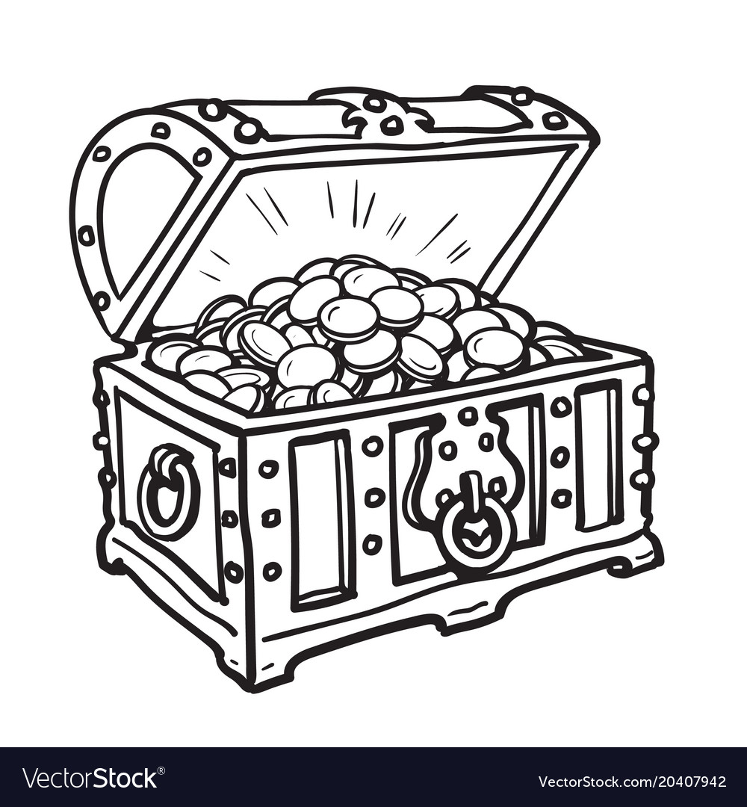
Adversarial Machine Learning as a Game
AML is a game played between an adversary and a machine learning (ML) model, over certain interests.
Usually, it is a zero-sum game.
Not always a BAD thing (GAN, adversarial training, etc.)
AML is a threat from the perspectives of cybersecurity, trustworthiness, and privacy.
Adversary
ML model (Defender)

Slide 7


Adversarial Machine Learning as a Game
It is more about “who wins in the end”.
In the beginning:
Bad ending (e.g., Adversarial example, neural backdoor, inference attacks)
Adaptive Adversary
Static Defender
Good ending (e.g., GAN, adversarial training)
Static Adversary
Adaptive Defender

Slide 8
Island of Adversarial Machine Learning
Start the game of AML
Game Theory Desert
Lurking in the dark
Den of AE
Search for them!
Vanguard of AE
You shall never pass !
Fort of Light
Farewell
Travel Point
Abbreviations:
AE: Adversarial Examples
AML: Adversarial Machine Learning
Sea of Machine Learning

Slide 9
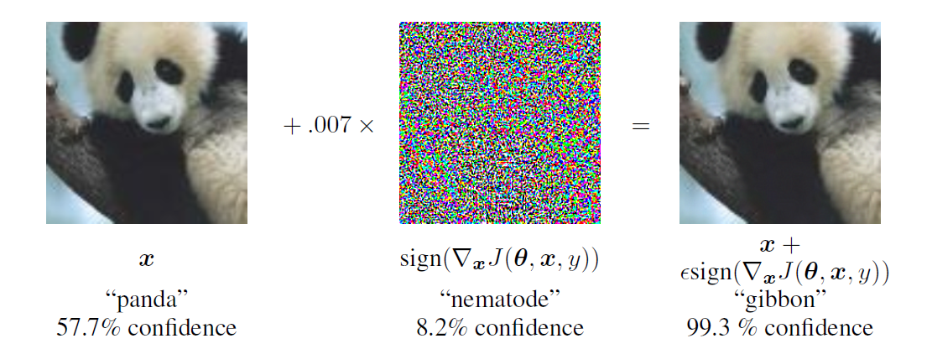
Adversarial Example
An Adversarial Example (AE) is a maliciously modified data example.
AE creates a perceptual discrepancy between a ML model and a human.
The malicious modification, called perturbation, is imperceptible to human.

Slide 10
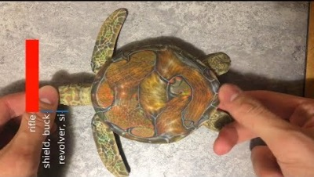
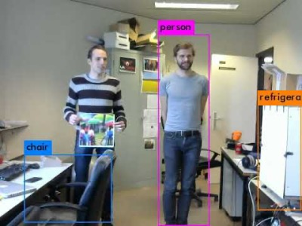
Impact of AE Attacks
AEs can be made into physical objects;
AEs can be found in a variety of applications.

Slide 11
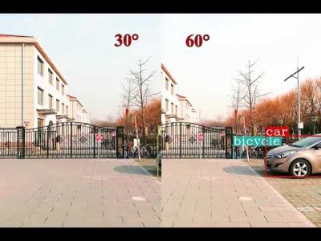
Impact of AE Attacks
AEs are practical threats that can actually result in lethal damages !

Slide 12
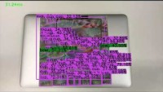
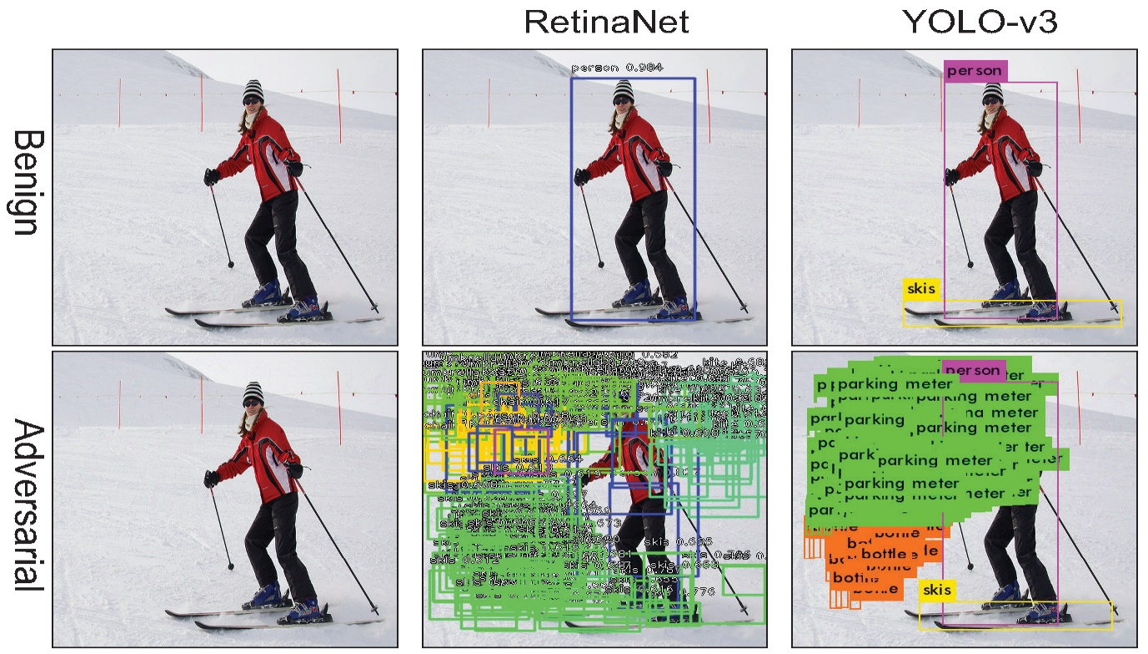
Impact of AE Attacks
AEs works against both classification and regression

Slide 13
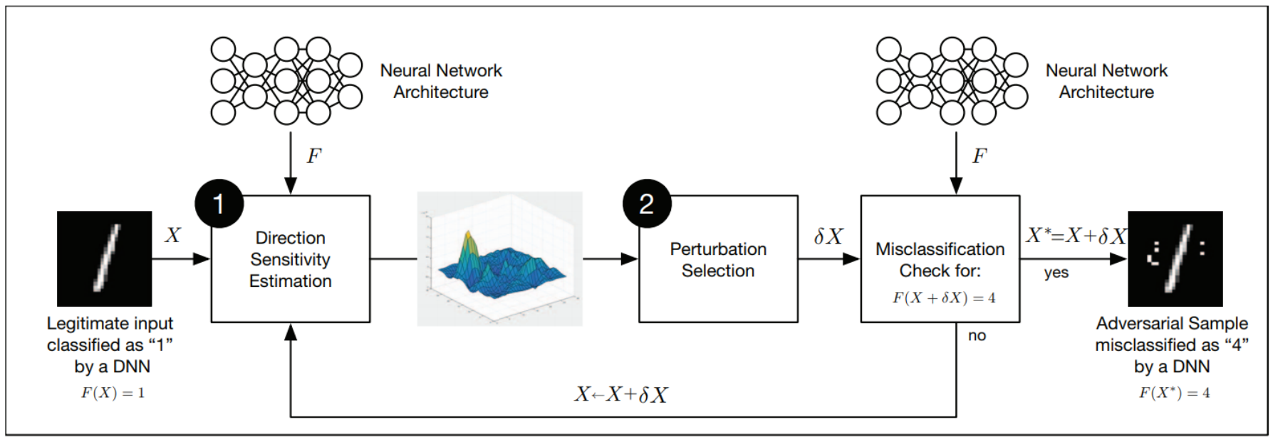
What do we need for making AEs?
Finding AE is essentially an optimization task
AE attacks happens in the inference stage of a DNN.
The adversary modifies a benign image before passing it to the DNN.
The adversary can use either gradient-based optimization or zeroth-order optimization.

Slide 14
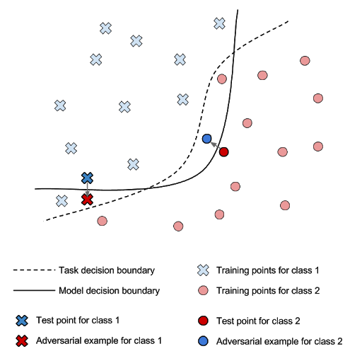
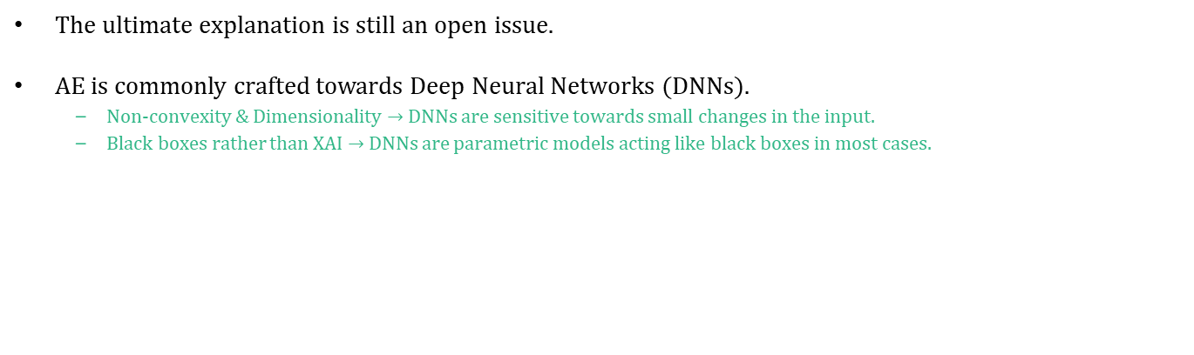
Why do AEs Exist?
The ultimate explanation is still an open issue.
AE is commonly crafted towards Deep Neural Networks (DNNs).
Non-convexity & Dimensionality $→$ DNNs are sensitive towards small changes in the input.
Black boxes rather than XAI $→$ DNNs are parametric models acting like black boxes in most cases.

Slide 15
Island of Adversarial Machine Learning
Start the game of AML
Game Theory Desert
Lurking in the dark
Den of AE
Search for them!
Vanguard of AE
You shall never pass !
Fort of Light
Farewell
Travel Point
Abbreviations:
AE: Adversarial Examples
AML: Adversarial Machine Learning
Sea of Machine Learning

Slide 16
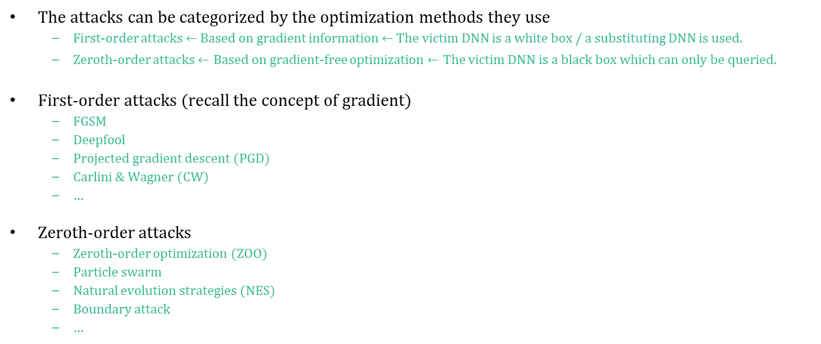
Strategies of the Adversary
The attacks can be categorized by the optimization methods they use
First-order attacks $←$ Based on gradient information $←$ The victim DNN is a white box / a substituting DNN is used.
Zeroth-order attacks $←$ Based on gradient-free optimization $←$ The victim DNN is a black box which can only be queried.
First-order attacks (recall the concept of gradient)
FGSM
Deepfool
Projected gradient descent (PGD)
Carlini & Wagner (CW)
…
Zeroth-order attacks
Zeroth-order optimization (ZOO)
Particle swarm
Natural evolution strategies (NES)
Boundary attack
…

Slide 17

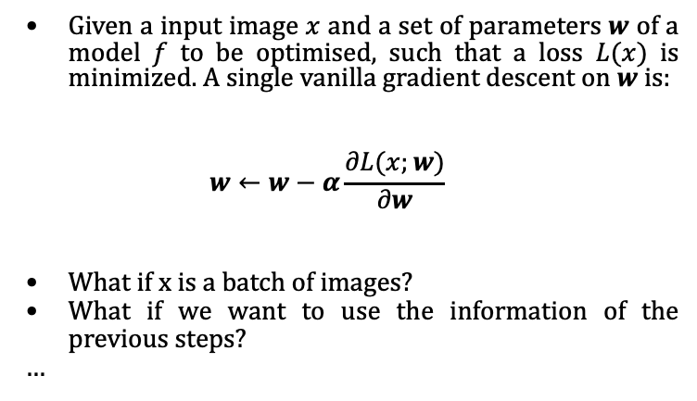
Gradient Descent
Given a input image $x$ and a set of parameters $w$ of a model $f$ to be optimised, such that a loss $L(x)$ is minimized. A single vanilla gradient descent on $w$ is:
$$w←w−α\frac{∂L(x;w)}{∂w}$$
What if x is a batch of images?
What if we want to use the information of the previous steps?
…

Slide 18
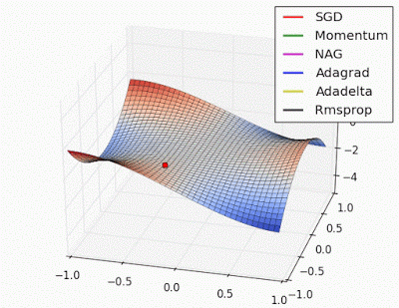
Available gradient descent methods
Yes, there are more methods.

Slide 19
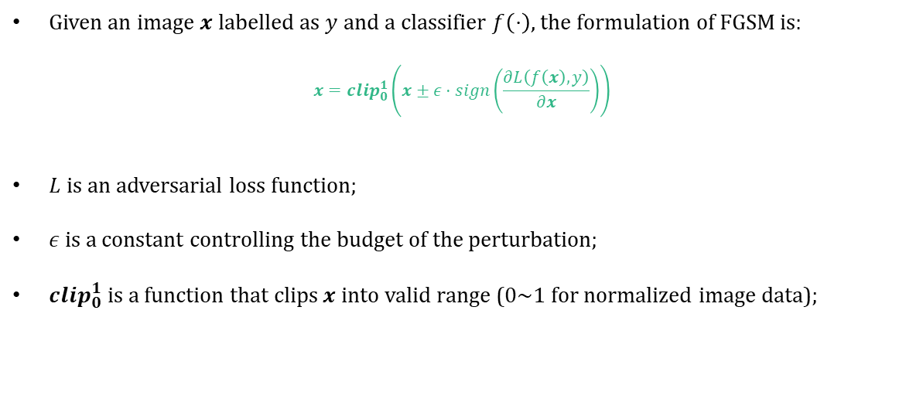
Fast Gradient Sign Method (FGSM) $→$ First-Order
Given an image $x$ labelled as $y$ and a classifier $f\left(⋅\right)$, the formulation of FGSM is:
$$x=clip_{0}^{1}\left(x±ε⋅sign\left(\frac{∂L\left(f\left(x\right), y\right)}{∂x}\right)\right)$$
$L$ is an adversarial loss function;
$ε$ is a constant controlling the budget of the perturbation;
$clip_{0}^{1}$ is a function that clips $x$ into valid range (0~1 for normalized image data);

Slide 20
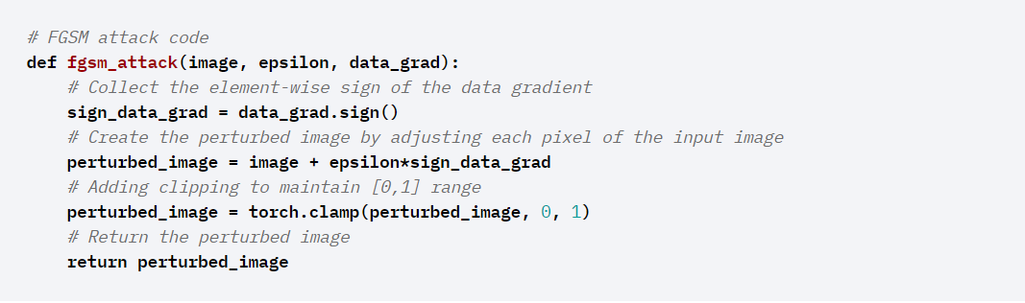
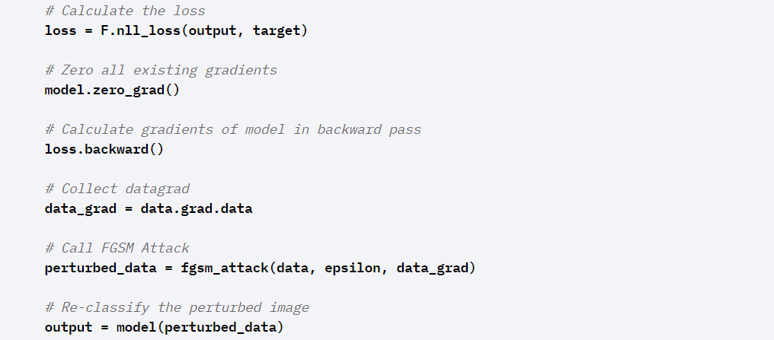
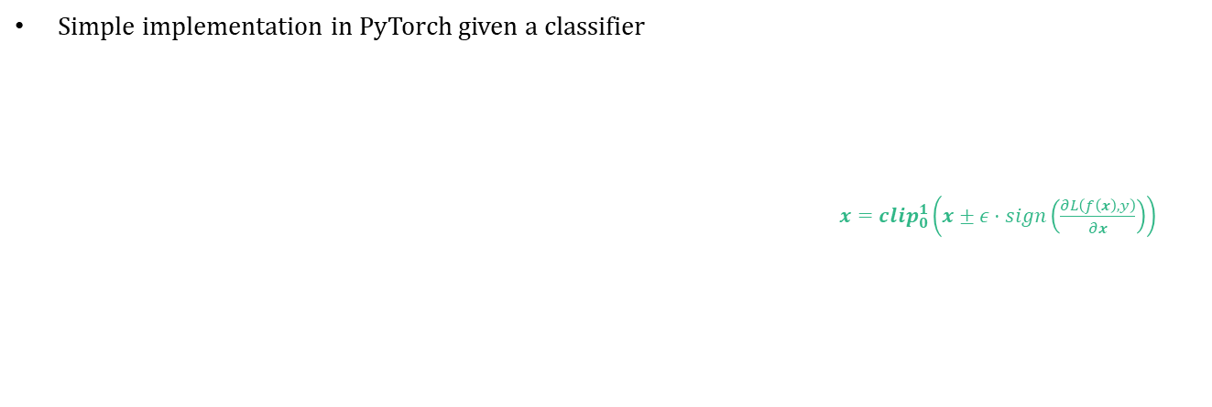
Fast Gradient Sign Method (FGSM) $→$ First-Order
Simple implementation in PyTorch given a classifier
$x=clip_{0}^{1}\left(x±ε⋅sign\left(\frac{∂L\left(f\left(x\right), y\right)}{∂x}\right)\right)$

Slide 21
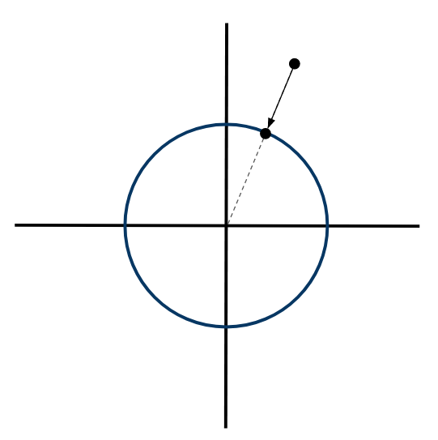
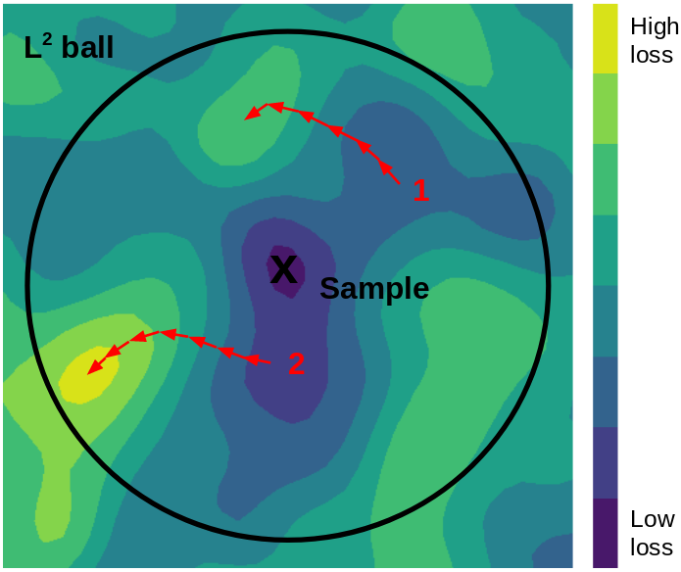
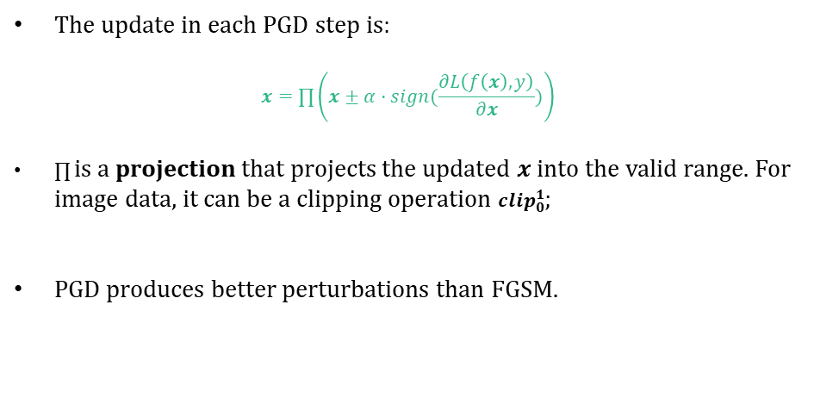
Projected Gradient Descent (PGD) $→$ First-Order
The update in each PGD step is:
$$x=∏\left(x±α⋅sign(\frac{∂L\left(f\left(x\right), y\right)}{∂x})\right)$$
$∏$ is a projection that projects the updated $x$ into the valid range. For image data, it can be a clipping operation $clip_{0}^{1}$;
PGD produces better perturbations than FGSM.

Slide 22
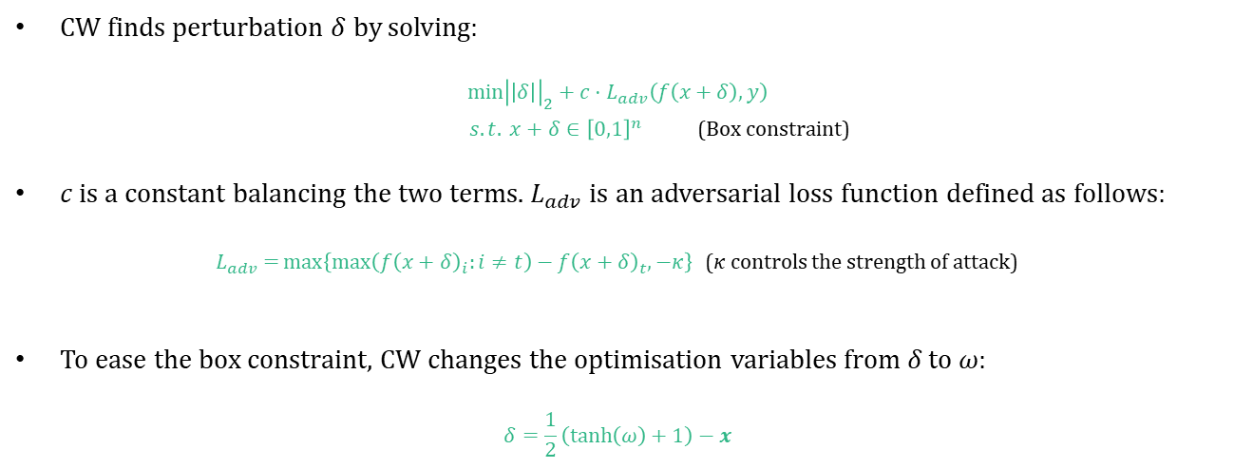
Carlini & Wagner (CW) $→$ First-Order
CW finds perturbation $δ$ by solving:
$${\min\left|\left|δ\right|\right|}_{2}+c⋅L_{adv}\left(f\left(x+δ\right), y\right)$$
$s.t. x+δ∈{\left[0,1\right]}^{n}$ (Box constraint)
𝑐 is a constant balancing the two terms. $L_{adv}$ is an adversarial loss function defined as follows:
$L_{adv}={\max\left\{\max\left(f{\left(x+δ\right)}_{i}:i≠t\right)−f{\left(x+δ\right)}_{t}, −κ\right\}}$ ($κ$ controls the strength of attack)
To ease the box constraint, CW changes the optimisation variables from 𝛿 to 𝜔:
$$δ=\frac{1}{2}\left(\tanh\left(ω\right)+1\right)−x$$

Slide 23
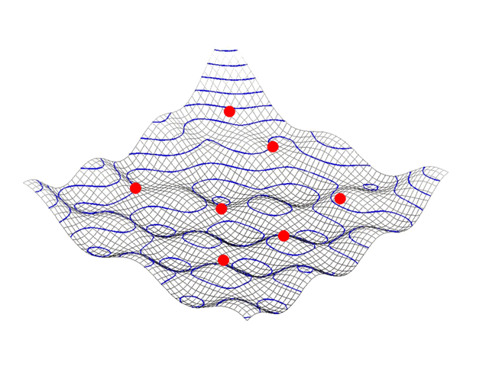
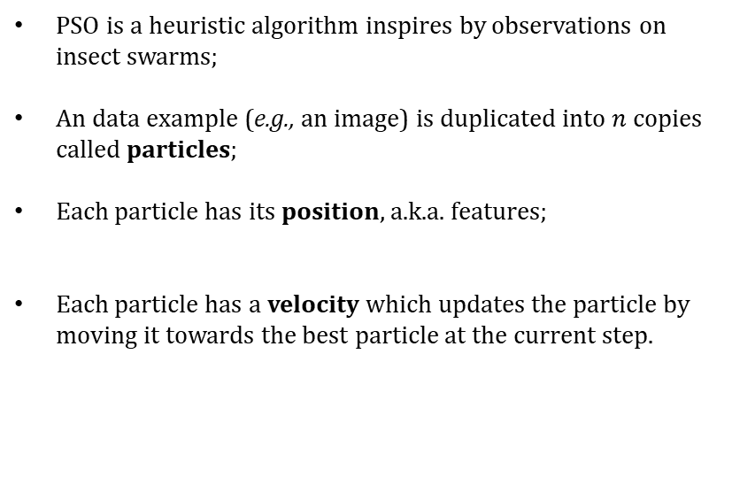
Particle Swarm (PS) $→$ Zeroth-Order
PSO is a heuristic algorithm inspires by observations on insect swarms;
An data example (e.g., an image) is duplicated into $n$ copies called particles;
Each particle has its position, a.k.a. features;
Each particle has a velocity which updates the particle by moving it towards the best particle at the current step.

Slide 24
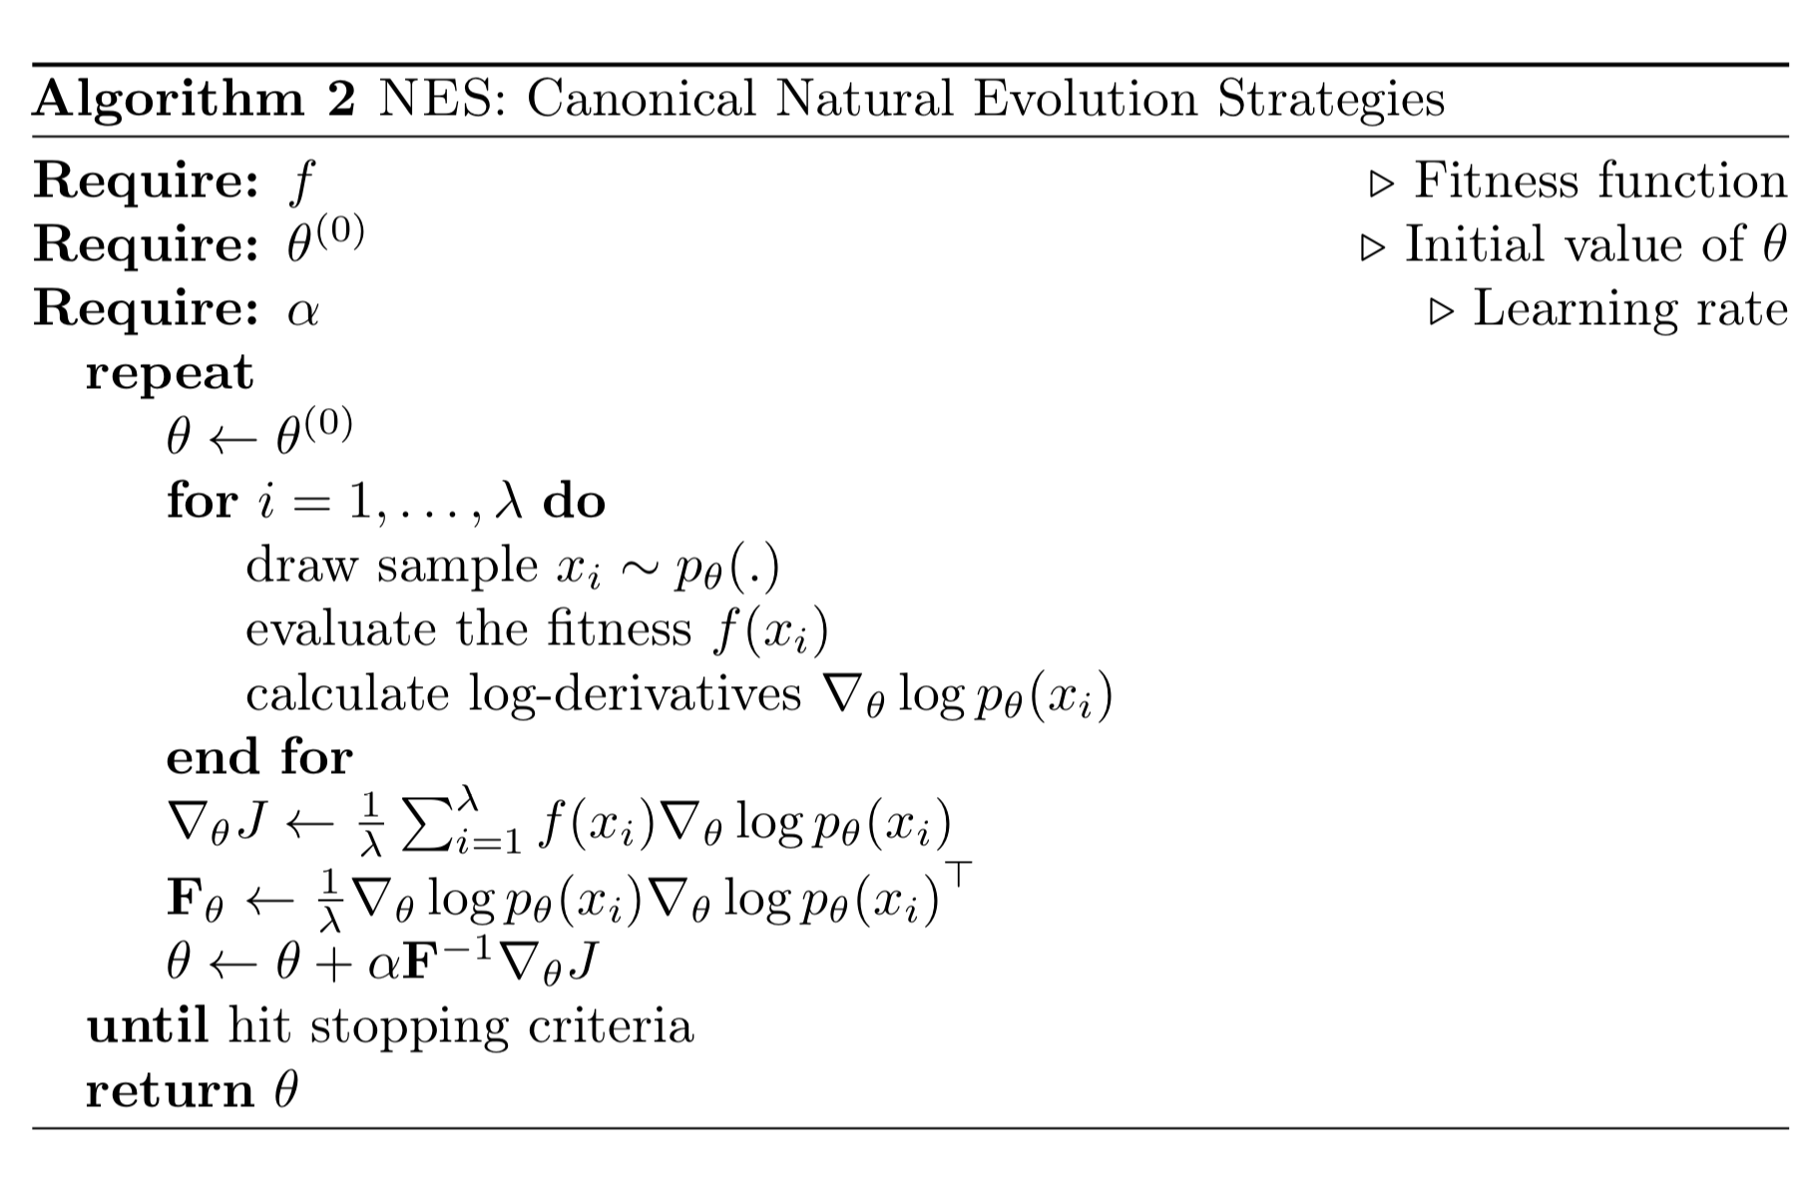
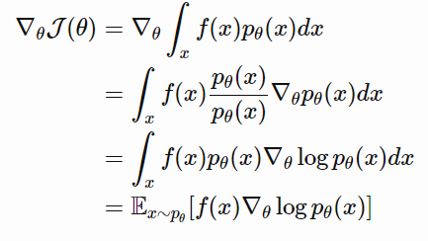
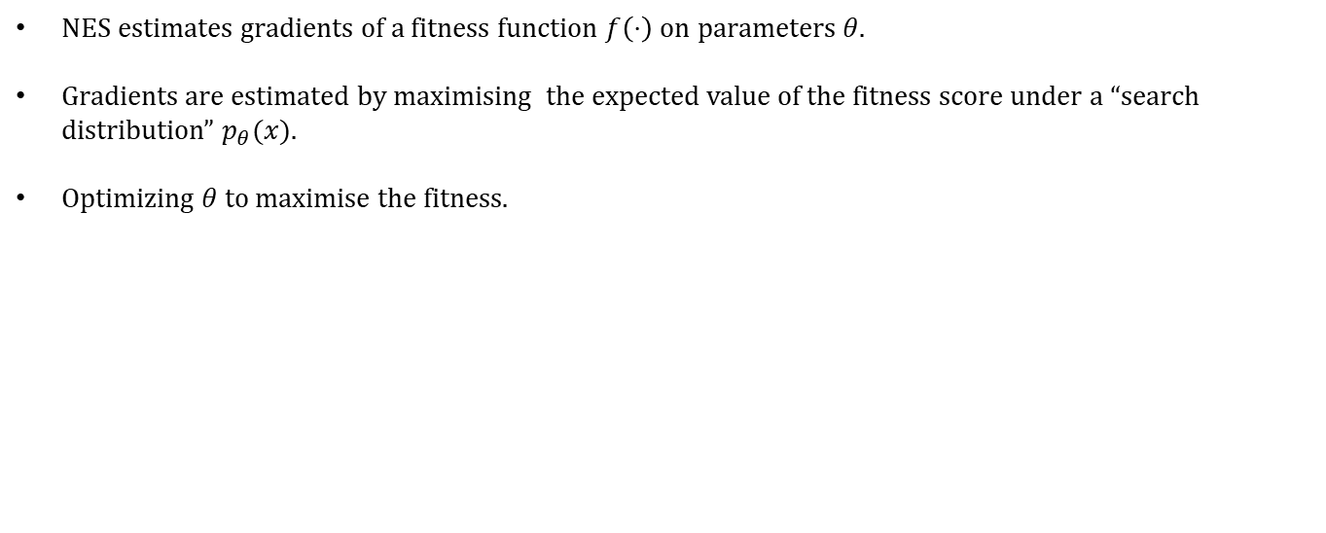
Natural Evolution Strategies (NES) $→$ Zeroth-Order
NES estimates gradients of a fitness function $f\left(⋅\right)$ on parameters $θ$.
Gradients are estimated by maximising the expected value of the fitness score under a “search distribution” $p_{θ}(x)$.
Optimizing $θ$ to maximise the fitness.

Slide 25
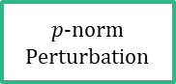
Trends in AE Attacks
Less priors over the victims
Smarter perturbation strategy
More constraints
First-order attacks
White-box Victims
$p$-norm Perturbation
Image Classification
Zeroth-order attacks
Black-box Victims
Object Detection
Decision-based attacks
Unrestricted Perturbation
NLP/
Source Code
Partial Prediction Scores / Label Only
……

Slide 26
Island of Adversarial Machine Learning
Start the game of AML
Game Theory Desert
Lurking in the dark
Den of AE
Search for them!
Vanguard of AE
You shall never pass !
Fort of Light
Farewell
Travel Point
Abbreviations:
AE: Adversarial Examples
AML: Adversarial Machine Learning
Sea of Machine Learning

Slide 27
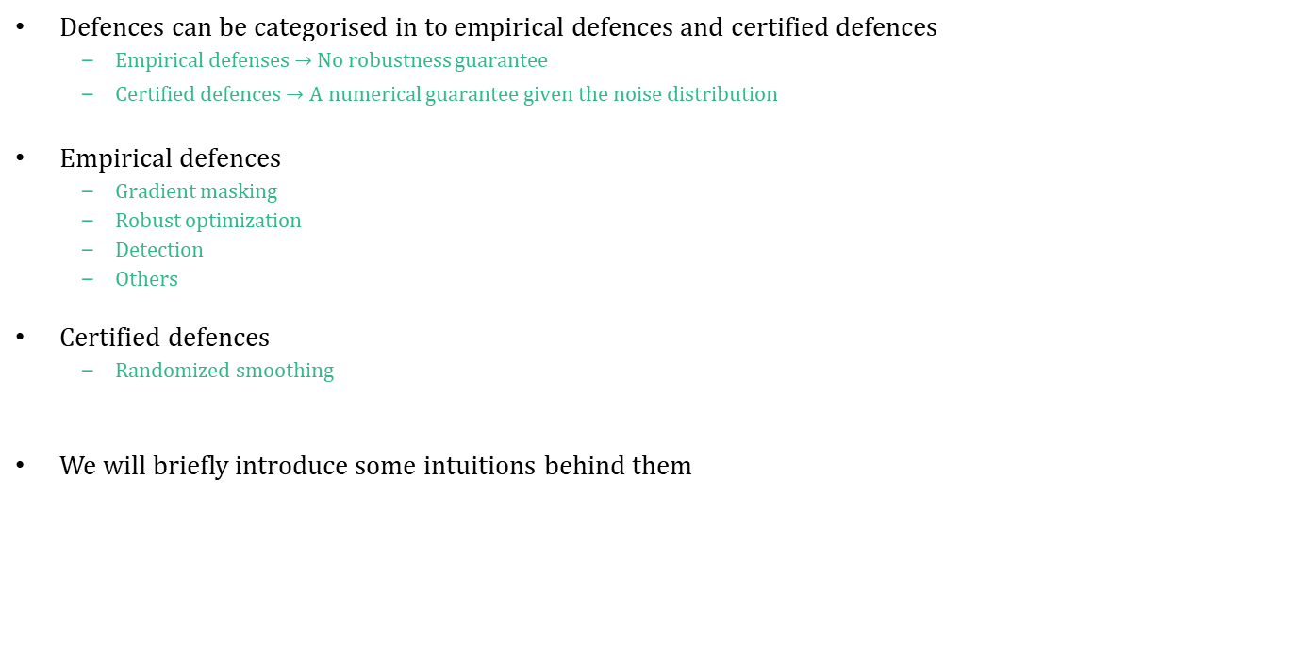
Strategies of the Defender
Defences can be categorised in to empirical defences and certified defences
Empirical defenses $→$ No robustness guarantee
Certified defences $→$ A numerical guarantee given the noise distribution
Empirical defences
Gradient masking
Robust optimization
Detection
Others
Certified defences
Randomized smoothing
We will briefly introduce some intuitions behind them

Slide 28
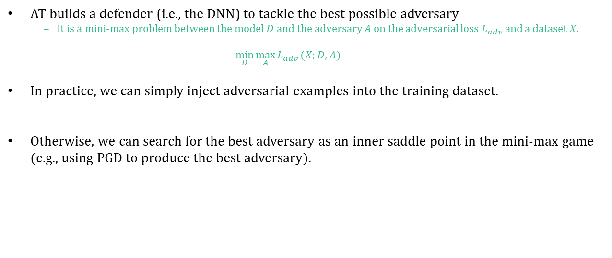
Adversarial Training (AT) $→$ Empirical
AT builds a defender (i.e., the DNN) to tackle the best possible adversary
It is a mini-max problem between the model $D$ and the adversary $A$ on the adversarial loss $L_{adv}$ and a dataset $X$.
$$\min_{D}\max_{A}{L_{adv}}(X;D,A)$$
In practice, we can simply inject adversarial examples into the training dataset.
Otherwise, we can search for the best adversary as an inner saddle point in the mini-max game (e.g., using PGD to produce the best adversary).
A Good Ending

Slide 29
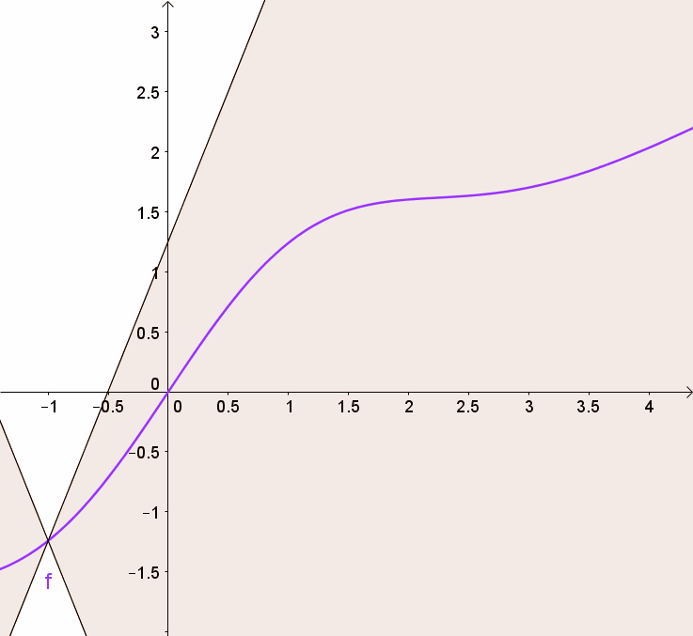
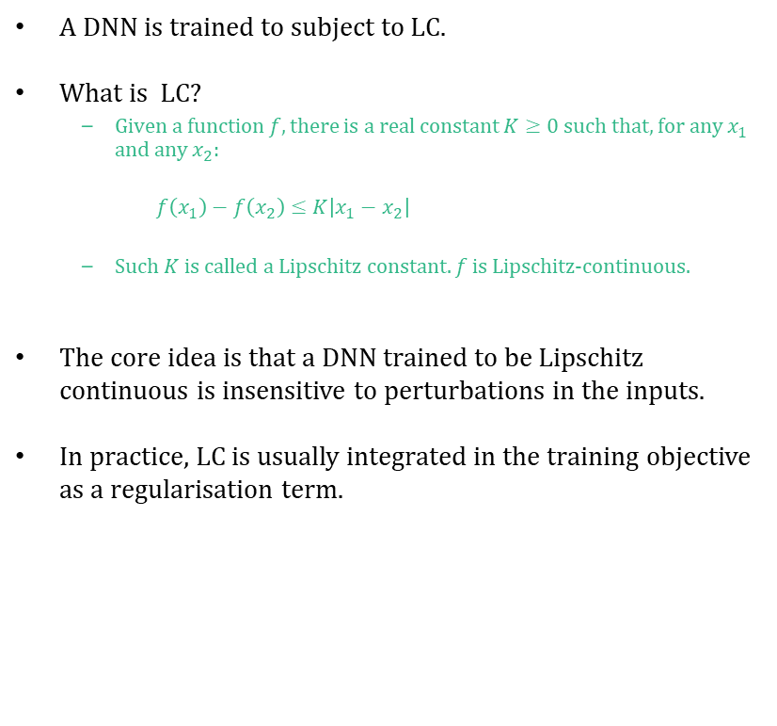
Lipschitz Continuity (LC) $→$ Empirical
A DNN is trained to subject to LC.
What is LC?
Given a function $f$, there is a real constant $K≥0$such that, for any $x_{1}$ and any $x_{2}$:
$f\left(x_{1}\right)−f\left(x_{2}\right)≤K\left|x_{1}−x_{2}\right|$
Such $K$ is called a Lipschitz constant. $f$ is Lipschitz-continuous.
The core idea is that a DNN trained to be Lipschitz continuous is insensitive to perturbations in the inputs.
In practice, LC is usually integrated in the training objective as a regularisation term.

Slide 30
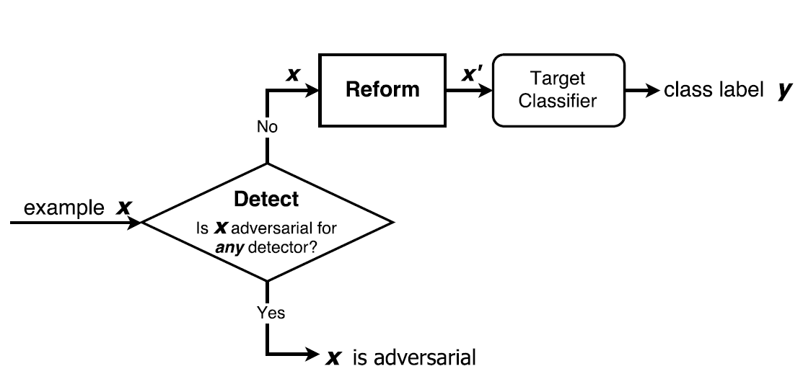
Detection (DT) $→$ Empirical
A common wisdom of detecting AE is to build a second “path” for prediction, in order to create a discrepancy in the prediction results when there is an AE.
For example, detection can be made by denoising/reforming the input data in the second path.

Slide 31
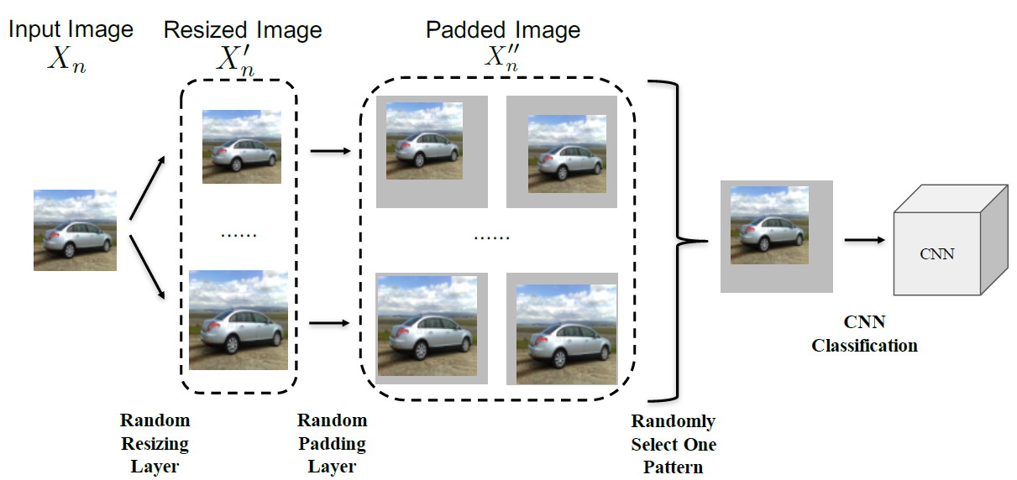
Input Randomization (IR) $→$ Empirical
IR adds random noise to the input, or transform the input to eliminate the impact of adversarial perturbations

Slide 32
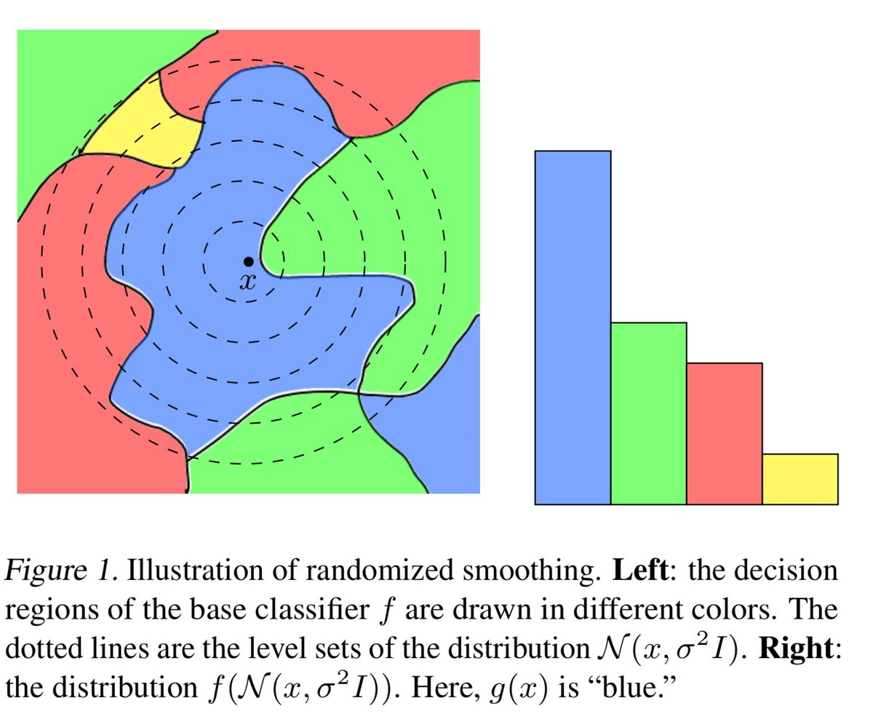
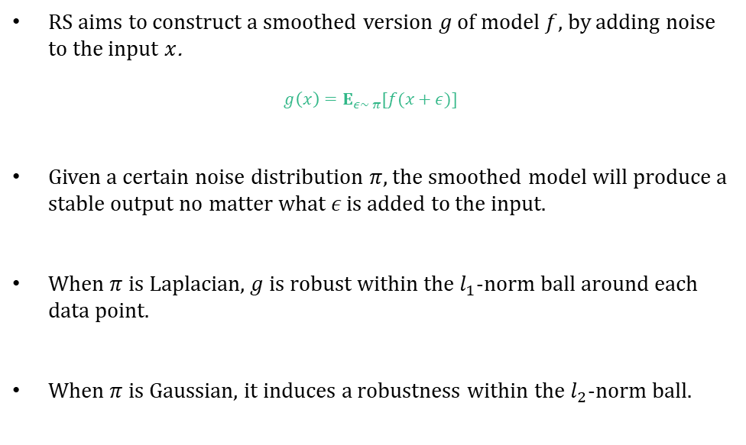
Randomized Smoothing (RS) $→$ Certified
RS aims to construct a smoothed version $g$ of model $f$, by adding noise to the input $x$.
$$g\left(x\right)=E_{ε∼ π}[f(x+ε)]$$
Given a certain noise distribution $π$, the smoothed model will produce a stable output no matter what $ε$ is added to the input.
When $π$ is Laplacian, $g$ is robust within the $l_{1}$-norm ball around each data point.
When $π$ is Gaussian, it induces a robustness within the $l_{2}$-norm ball.

Slide 33
Island of Adversarial Machine Learning
Start the game of AML
Game Theory Desert
Lurking in the dark
Den of AE
Search for them!
Vanguard of AE
You shall never pass !
Fort of Light
Farewell
Travel Point
Abbreviations:
AE: Adversarial Examples
AML: Adversarial Machine Learning
Sea of Machine Learning

Slide 34
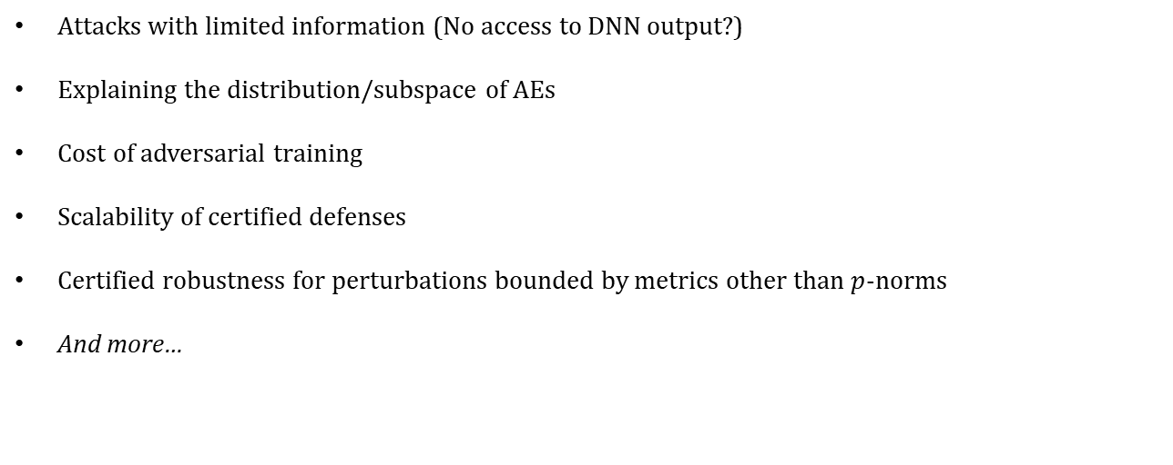
Open Issues in AE Attacks/Defenses
Attacks with limited information (No access to DNN output?)
Explaining the distribution/subspace of AEs
Cost of adversarial training
Scalability of certified defenses
Certified robustness for perturbations bounded by metrics other than $p$-norms
And more…

Slide 35
Thank you
Derui (Derek) Wang [王 德睿]

